Slide 1
IBM University Engagement Project Submission
“Exploring the Power of Agentic AI with IBM Cloud and Orchestrate”

Slide 2


Project Tile – AI Energy Efficiency Optimization Agent
Domain of Project – Mechanical
Student Name | Recent Passport Photo | Email ID | Mobile number [WhatsApp]
Amrut Pramod More |  | amrut20262+ibm@gmail.com | 7028616375

Slide 3
Problem Statement -
Problem Statement : Nutrition Agent
The Challenge
Mechanical systems such as HVAC units, compressors, turbines, and industrial machines consume large amounts of energy. Inefficient operation increases operational costs and environmental impact. Organizations often lack advanced tools to analyze energy consumption patterns and identify opportunities for optimization.
The Objective
Build an AI-powered Energy Efficiency Optimization Agent that analyzes mechanical system data and recommends improvements to reduce energy consumption.
Energy Data Retrieval (RAG) :– Collect energy consumption data and operational parameters.
Efficiency Analysis :– Identify inefficiencies in machine operations. Optimization Recommendations :– Suggest operational adjustments or system improvements.
Energy Forecasting :– Predict future energy consumption trends.
Multi-Agent System • Energy Monitoring Agent – Collects energy consumption data. • Efficiency Analysis Agent – Detects inefficient operations. • Optimization Agent – Recommends energy-saving strategies. • Forecasting Agent – Predicts future energy usage.
Visualization Dashboard Display energy consumption trends, efficiency indicators, and optimization recommendations.

Slide 4
Proposed Solution -
The AI Energy Efficiency Optimization Agent is an intelligent decision-support system designed to reduce energy consumption and improve the operational efficiency of mechanical systems such as HVAC units, compressors, turbines, pumps, and industrial machinery. It leverages IBM Langflow/IBM Orchestrate, Large Language Models (LLMs), Retrieval-Augmented Generation (RAG), and a Multi-Agent Architecture to analyze energy data, identify inefficiencies, recommend optimization strategies, and forecast future energy usage.
Solution Workflow
Energy Data Collection
Retrieval-Augmented Generation (RAG) Multi-Agent Processing
Energy Monitoring Agent
Efficiency Analysis Agent
Optimization Agent
Forecasting Agent
AI-Based Analysis
Interactive Dashboard
Decision Support

Slide 5
Technology Used
Langflow platform -For designing and orchestrating multi-agent workflows visually
IBM Granite model - for eg – ibm-granite-3-2-8b – For natural language understanding, reasoning, and personalization
IBM Cloud – It provides the infrastructure to build, deploy, and scale the Nutrition Agent efficiently. IBM Cloud enables a reliable, secure, and scalable environment for deploying the Nutrition Agent.
RAG– RAG to fetch real data first, then generate intelligent answers, making the Nutrition Agent more trustworthy and effective.
IBM Watsonx.ai - For model deployment, embeddings, and AI governance
Vector Database (FAISS/Chroma) – For RAG-based nutritional data retrieval

Slide 6
Orchestrate component Used -
1) Chat Input – Interface where users enter their queries, preferences, or meal details (text/voice/image).
2) IBM watsonx AI Agent - Processes user input using Granite models to generate personalized nutrition insights and recommendations.
3) Name of IBM Granite model - Granite-4.0-8B-Instruct → Fast, efficient for real-time diet recommendations
4) Chat output -Displays AI-generated responses such as diet plans, nutritional analysis, and health suggestions.
5) File component - Stores and retrieves user data, meal logs, and nutritional datasets for analysis and tracking.
6) Add name of any other component used.

Slide 7
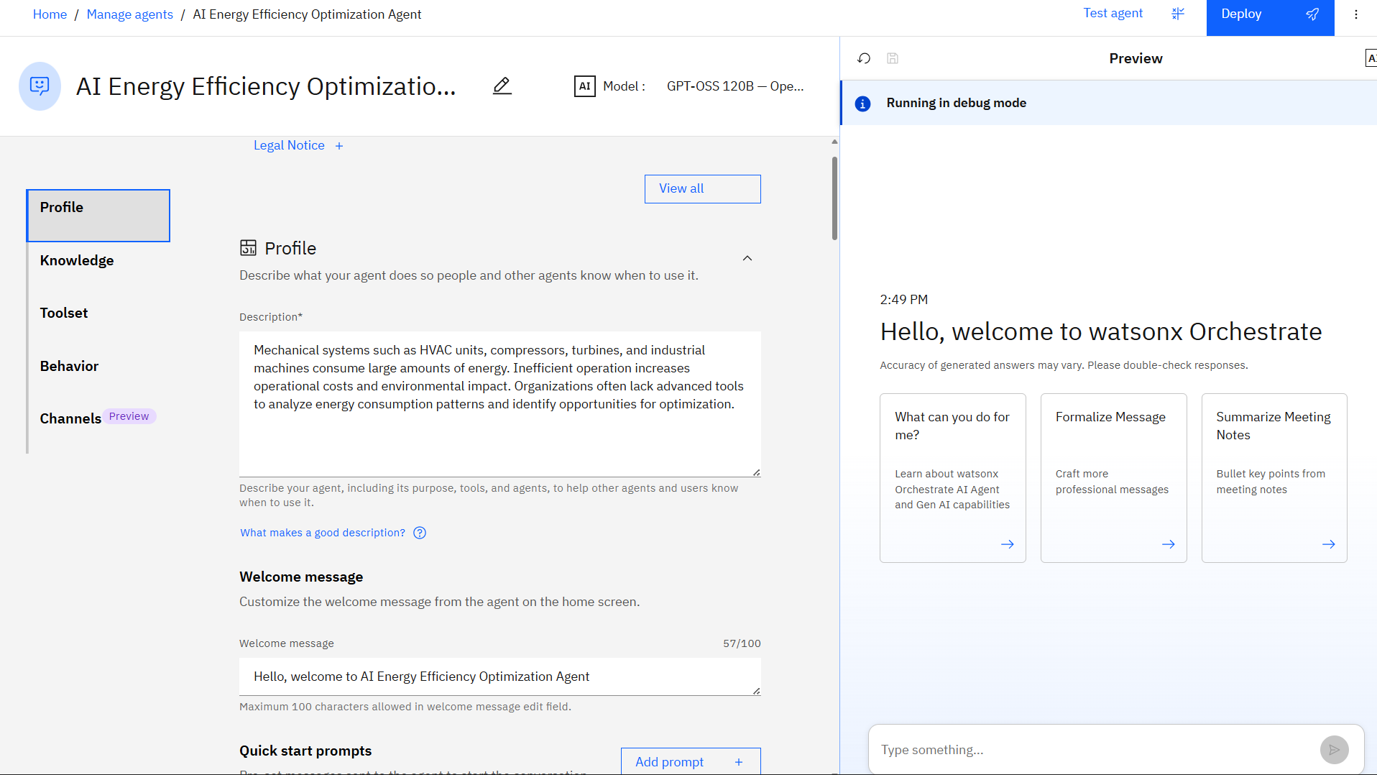
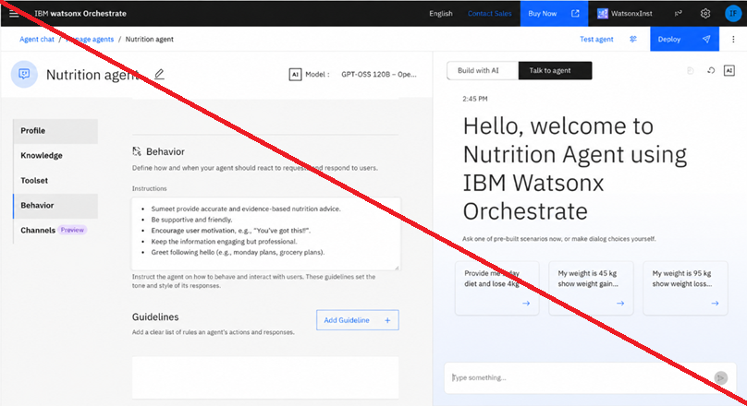
Agent Instructions Screenshot-

Slide 8
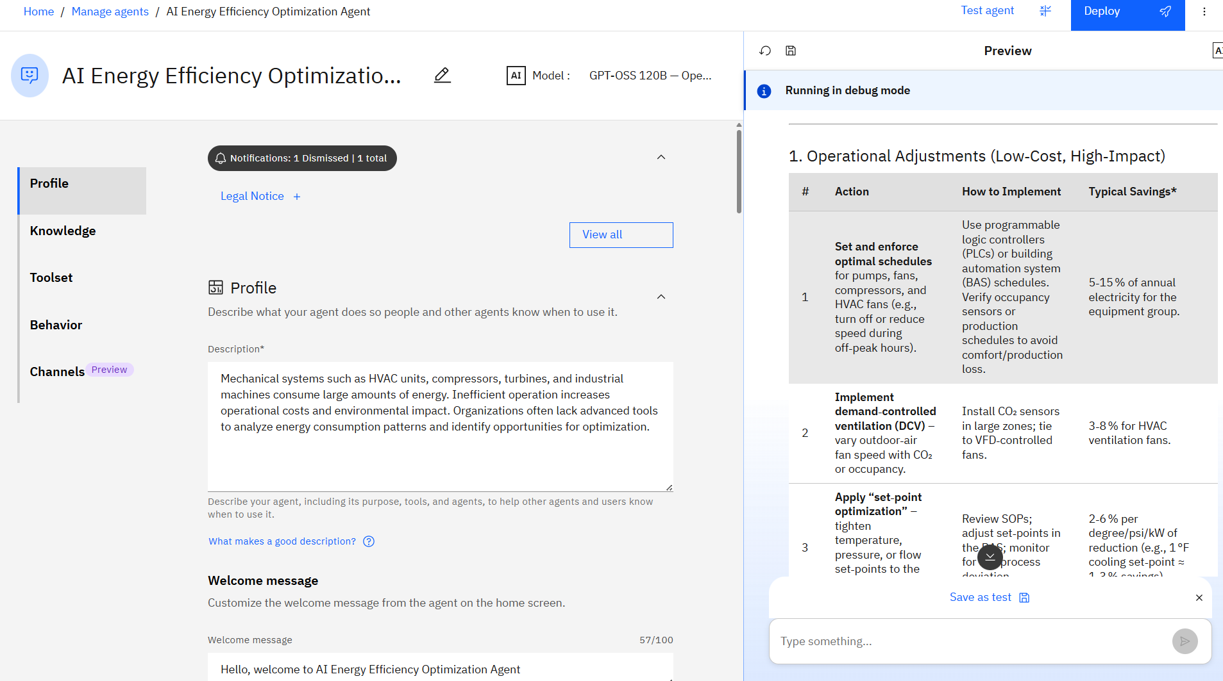
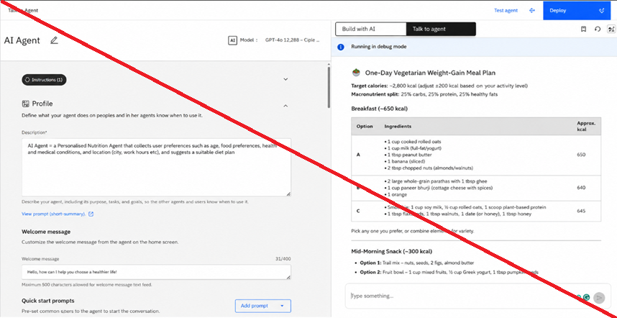
Prompt with output Screenshot:
-Use different slides for multiple screenshots

Slide 9
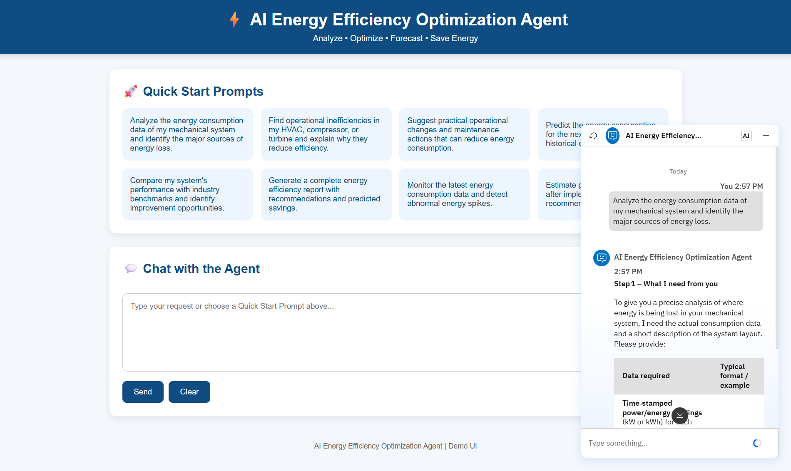
Frontend :
- Put multiple screenshots for multiple prompts and outputs
All the content screenshots should be clearly visible

Slide 10

Orchestrate architecture blueprint

Slide 11

Role of Agentic AI in the solution
Agentic AI plays a central role in the proposed AI Energy Efficiency Optimization Agent by enabling autonomous, intelligent, and collaborative decision-making for mechanical systems such as HVAC units, compressors, turbines, and industrial machines. Instead of relying on a single AI model, the system employs multiple specialized AI agents that work together to monitor energy usage, analyze system performance, recommend optimizations, and predict future energy consumption.
The Energy Monitoring Agent continuously collects real-time and historical energy consumption data along with operational parameters. The Efficiency Analysis Agent processes this information to identify abnormal energy usage, inefficient operating conditions, and potential performance issues. Based on these findings, the Optimization Agent generates practical recommendations, including operational adjustments, preventive maintenance, and energy-saving strategies to improve system efficiency. Finally, the Forecasting Agent predicts future energy demand using historical trends, enabling proactive planning and resource management.
To enhance decision-making, the system integrates Retrieval-Augmented Generation (RAG), allowing agents to retrieve relevant equipment manuals, maintenance records, and energy standards before generating recommendations. This ensures responses are accurate, context-aware, and evidence-based. By combining autonomous monitoring, collaborative analysis, predictive intelligence, and explainable recommendations, Agentic AI helps organizations reduce energy consumption, lower operational costs, improve equipment reliability, and support long-term sustainability goals while minimizing the need for constant human intervention.

Slide 12
Novelty and Uniqueness
The solution combines Agentic AI, Retrieval-Augmented Generation (RAG), and multi-agent collaboration to deliver intelligent energy optimization. Unlike traditional monitoring systems, it not only detects inefficiencies but also provides context-aware recommendations, predicts future energy consumption, and explains decisions using technical documentation, enabling proactive, data-driven energy management and improved sustainability.

Slide 13
Git Hub Link
https://github.com/amrut20562/AI-Energy-Efficiency-Optimization-Agent.git
·
·
·

Slide 14
Future Scope
The system can be enhanced by integrating real-time IoT sensors, digital twins, and edge AI for continuous monitoring and faster decision-making. Future versions can support automated control of mechanical systems, predictive maintenance, carbon footprint tracking, renewable energy optimization, and integration with Building Management Systems (BMS), SCADA, and ERP platforms for enterprise-scale energy management.
·
·
·

Slide 15
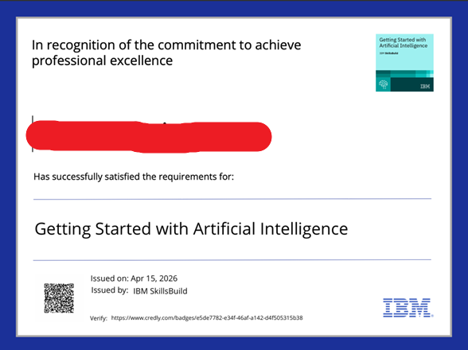
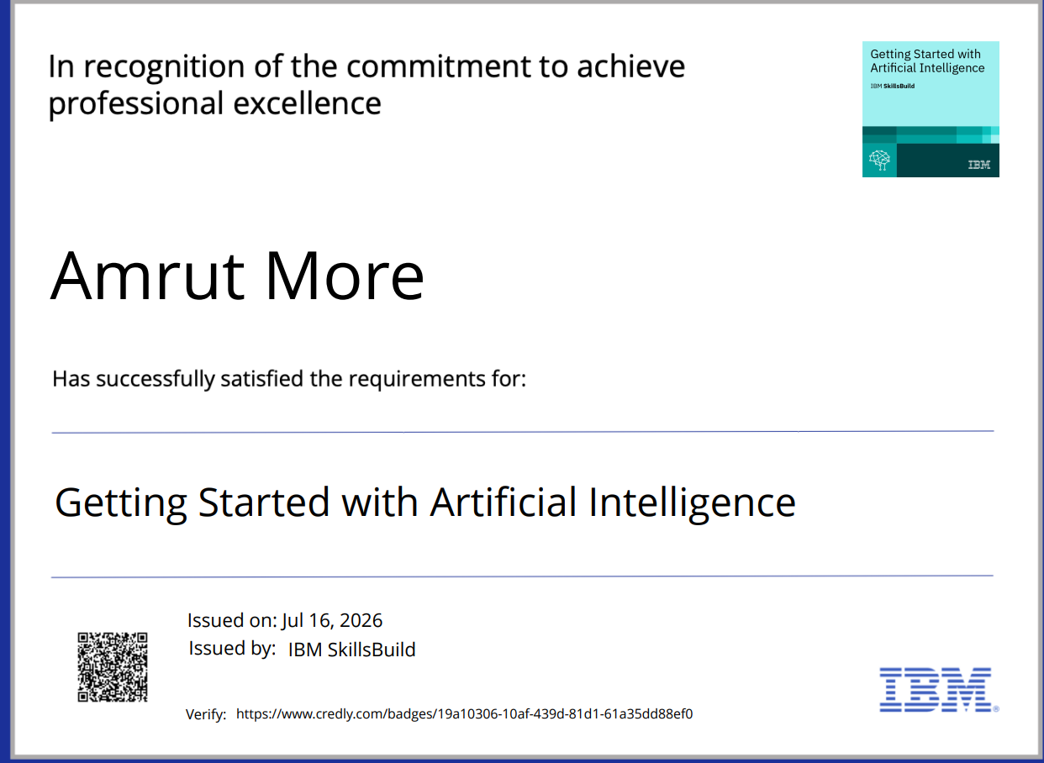
Certificates Earned:

Slide 16
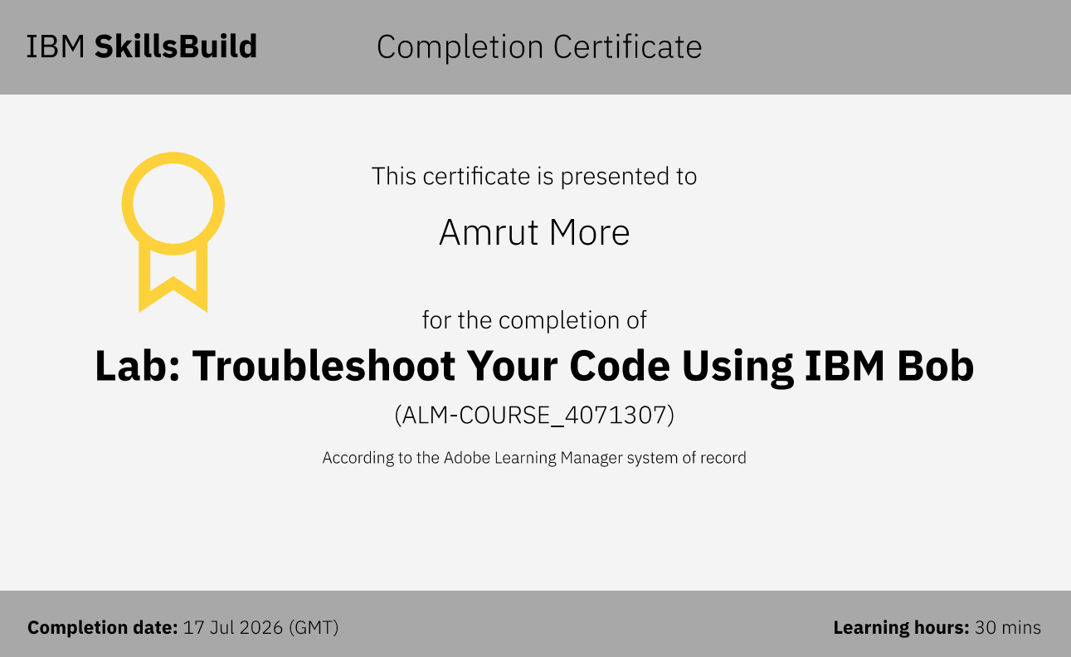

Certificates Earned:​

Slide 17


